Slide 1
NAME-400 Project & Thesis
Supervised by,
Dr. N. M. Golam Zakaria
Professor,
Dept. of NAME,
BUET.
Presented by,
Touseef Hasan
Student ID: 1812044,
Shamsul Islam
Student ID: 1812039.

Slide 2
Tentative Title
“ A Material Flow Analysis of the
Ship-Breaking Industry in Bangladesh
using Machine Learning. ”

Slide 3
Objectives
Review the ship-breaking industry in Bangladesh, focusing primarily
on its economic aspects.
2. Develop a machine learning model, using key factors – ship type,
market conditions, and historical data to predict the scrap value of
ships.
3. Conduct gap analysis of the existing literature and provide a projection
of ship scrap, based on relevant input parameters.

Slide 4
Methodology
1. Reviewing Existing Literature
2. Data Collection, Cleaning and Exploratory Data Analysis (EDA)
3. Feature Engineering
4. Machine Learning Model Development, Training & Testing
5. Model Evaluation and Interpretation
Notes:
EDA is analyzing data to understand the data, discover patterns and spot anomalies. Feature Engineering is the process of improving the performance of a machine learning model by selecting, transforming, and creating new variables based on domain knowledge and the characteristics of the dataset.

Slide 5
Data Collection
1. Defining the Problem Statement
Why must data be collected?
Where should unbiased data be collected from?
What is the current statistical standpoint of the ship breaking industry?
Which key factor indicates the total scrap weight of a recycled ship?
Do other factors impact scrap?
Is there a correlation/causation?
Notes:
LDT (Light Displacement Tonnage) represents the weight of a ship when it is completely empty, without any cargo, fuel, water, or supplies. This provides a baseline weight for the ship's structure, which is essential in estimating the total weight of scrap material that can be obtained.

Slide 6
Data Collection (contd.)
2. Creating a Dataset
Sourced from: Ministry of Industries, Motijheel C/A, Dhaka
Timeline of Collection: July 23, 2023 – August 30, 2023
Interval of Collected Data: January 2012 - December 2022
Total Unique Vessels Recorded: 1337
Ship Types Obtained: 48
Notes:
a.k.a. First Party data, because the data was collected directly from the responsible organization. Internal data, thus unbiased.
Gratitude to our thesis supervisor, collected data over a span of 5 weeks on Excel.
2018, 2019, 2020 was excluded.

Slide 7
Data Collection (contd.)
2. Creating a Dataset (contd.)

Slide 8
Data Pre-Processing/Cleaning
Removing duplicates Finding unique data points
Fixing structural errors Standardizing units for a certain parameter
Excluding outliers Ensuring a better fit
Notes:
80-90% time was spent on data collection and cleaning.

Slide 9
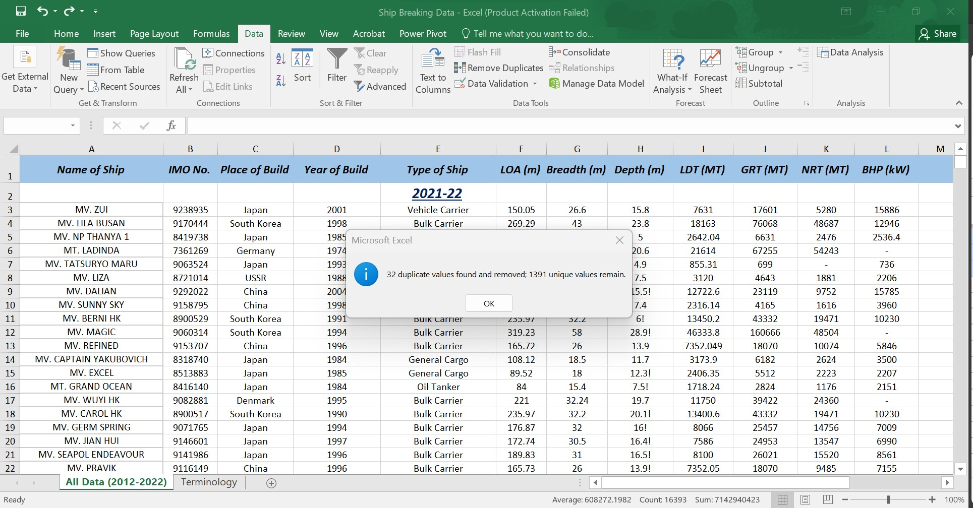
Data Pre-Processing/Cleaning (contd.)
Figure: Removal of duplicate values
Notes:
Done on Excel.

Slide 10
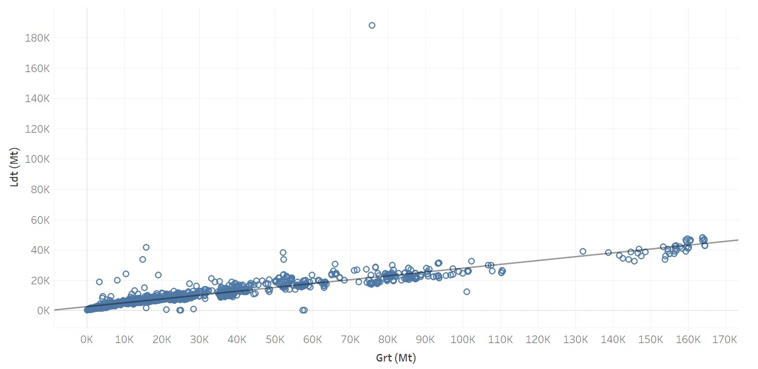
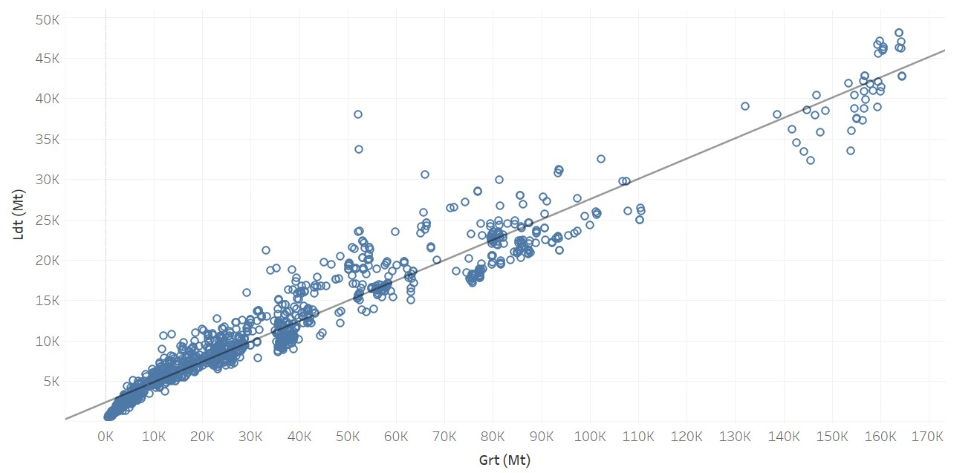
Data Pre-Processing/Cleaning (contd.)
Figure: Before excluding outliers
Figure: After excluding outliers
Notes:
Done on Tableau. Logical errors (LDT > GRT) were also excluded. If LDT > GRT, it would imply that the ship's structural components and equipment are heavier than the entire volume of the ship, which is physically impossible.

Slide 11
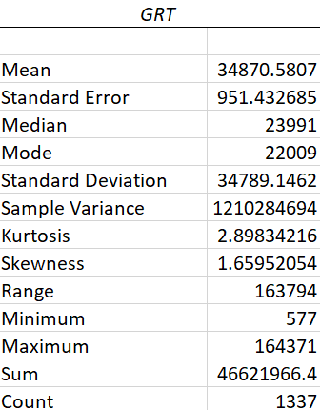
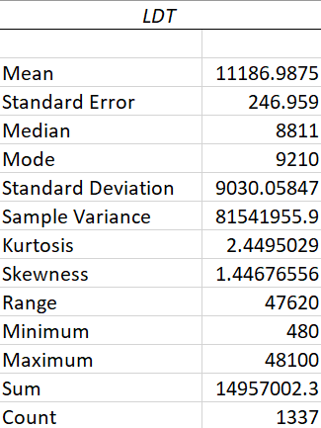
Exploratory Data Analysis
Figure: EDA for all unique ships, taking GRT and LDT as key parameters

Slide 12
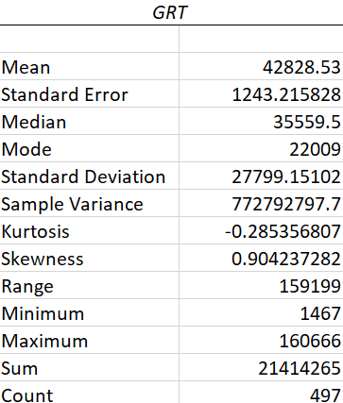
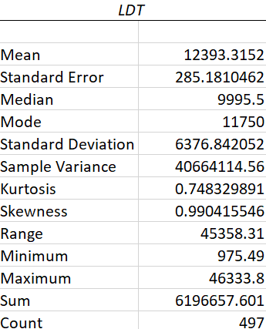
Exploratory Data Analysis (contd.)
Figure: EDA for all bulk carriers, taking GRT and LDT as key parameters

Slide 13
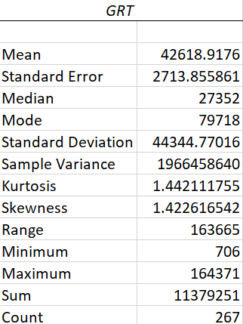
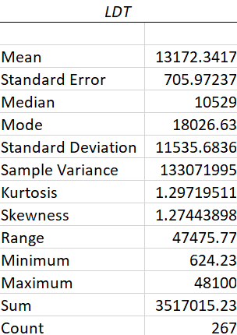
Exploratory Data Analysis (contd.)
Figure: EDA for all oil tankers, taking GRT and LDT as key parameters

Slide 14
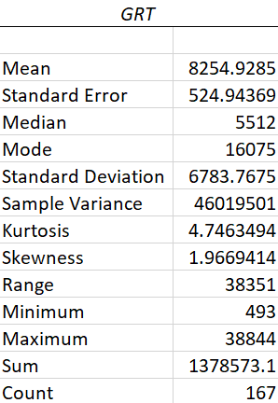
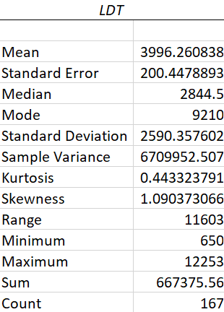
Exploratory Data Analysis (contd.)
Figure: EDA for all cargo vessels, taking GRT and LDT as key parameters

Slide 15
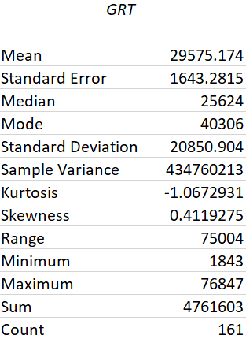
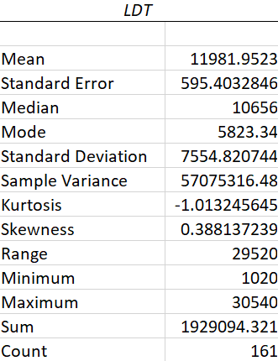
Exploratory Data Analysis (contd.)
Figure: EDA for all container ships, taking GRT and LDT as key parameters

Slide 16
Gap Analysis
Field Survey from 2011 Internal Data up to 2022
Regression from a 1983 Japanese Report Latest Data in Bangladesh
Small Sample of a few ship types Large Dataset of multifarious ship types
Notes:
Compared to existing literature. (2014)

Slide 17
Gap Analysis (contd.)
LDT = 0.2494*GRT + 2491 [combined]
LDT = 0.2201*GRT + 2993 [bulk carriers]
LDT = 0.2645*GRT + 2742
LDT = 0.2575*GRT + 2200 [oil tankers]
LDT = 0.3455*GRT + 1144 [cargo vessels]
LDT = 0.3599*GRT + 1139 [container ships]

Slide 18
Challenges
1. Dealing with missing values
2. Depth correction
3. Human error while recording data
Notes:
136 drafts.

Slide 19
References
Ministry of Industries, Motijheel C/A, Dhaka.
Hossain, A., Iqbal, K.S. and Zakaria, N.M.G.; Ship Recycling Prospects in Bangladesh, December, MARTEC 2010, Bangladesh.
Shameem, A.B.M; The Role of the Ship Breaking Industry in Bangladesh and its Future with Special Emphasis on Capacity Building Through Education and Training, M.Sc Thesis, 2012, World Maritime University, Sweden.
Rahman, Sohanur; Aspects and Impacts of Ship Recycling in Bangladesh, MARTEC 2016.
N. M. Golam Zakaria, Mir Tareque Ali and Kh. Akhter Hossain; Underlying Problems of Ship Recycling Industries in Bangladesh and Way Forward, Journal of Naval Architecture and Marine Engineering, December, 2012.
Hasan Ruhan Rabbi, Aevelina Rahman; Ship Breaking and Recycling Industry of Bangladesh; Issues and Challenges, MARTEC 2016.

Slide 20
Thank You.

